Slide 1
Introducing sparqs’ new resource on engaging Online Distance Learning students
Creating a learning community for online and distance students
University of the Highlands and Islands · Thursday 14 June 2018
Simon Varwell Development Consultant
Notes:
Likely structure:
Background to the project
Work we undertook – and the highlights
Challenges and opportunities for the project
Development of the resource
Key questions (eg restructure, new case studies)
Next steps

Slide 2
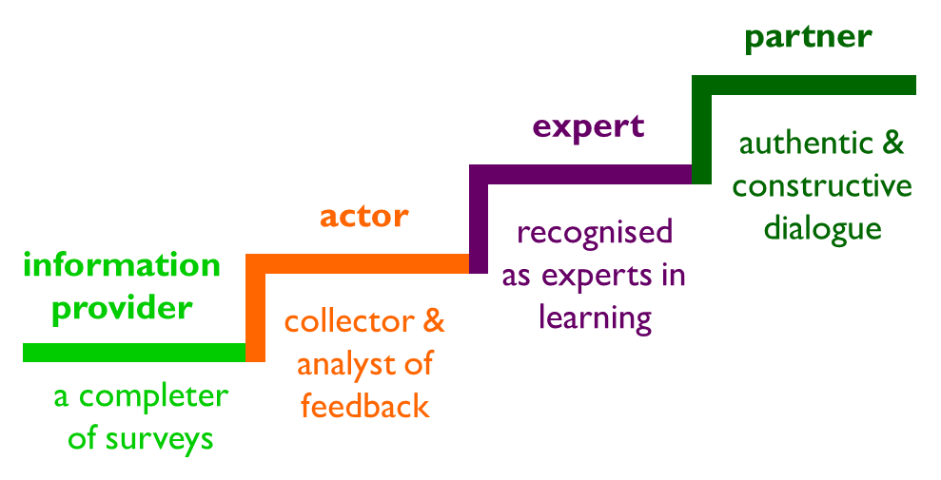
ODL students’ roles

Slide 3
About sparqs
Student Partnerships in Quality Scotland
Funded by Scottish Funding Council
Works with colleges, universities and SAs.
Supporting students
Supporting institutions
Supporting the sector
Developing a culture

Slide 4
Our vision
Students making a positive and rewarding difference to their own and others’ educational experience, helping shape the nature of learning and contributing to the overall success of Scotland’s universities and colleges

Slide 5
Our vision
Students making a positive and rewarding difference to their own and others’ educational experience, helping shape the nature of learning and contributing to the overall success of Scotland’s universities and colleges

Slide 7
A Student Engagement Framework for Scotland
There are five key elements:
Students feeling part of a supportive institution.
Students engaging in their own learning.
Students working with their institution in shaping the direction of learning.
Formal mechanisms for quality and governance.
Influencing the student experience at national level.
The use of the term ‘learning’ throughout the framework can apply to learning, teaching and assessment.

Slide 8
A Student Engagement Framework for Scotland
There are six features of effective student engagement:
A culture of engagement.
Students as partners.
Responding to diversity.
Valuing the student contribution.
Focus on enhancement and change.
Appropriate resources and support.

Slide 9
A Student Engagement Framework for Scotland
There are five key elements:
Students feeling part of a supportive institution.
Students engaging in their own learning.
Students working with their institution in shaping the direction of learning.
Formal mechanisms for quality and governance.
Influencing the student experience at national level.
The use of the term ‘learning’ throughout the framework can apply to learning, teaching and assessment.

Slide 10
The background
Defining ODL – what is online?
Challenges for students’ associations
Rep structures
Hearing the student voice
Challenges for institutions:
Surveys and meetings
Accessing “campus” services
Identity

Slide 11
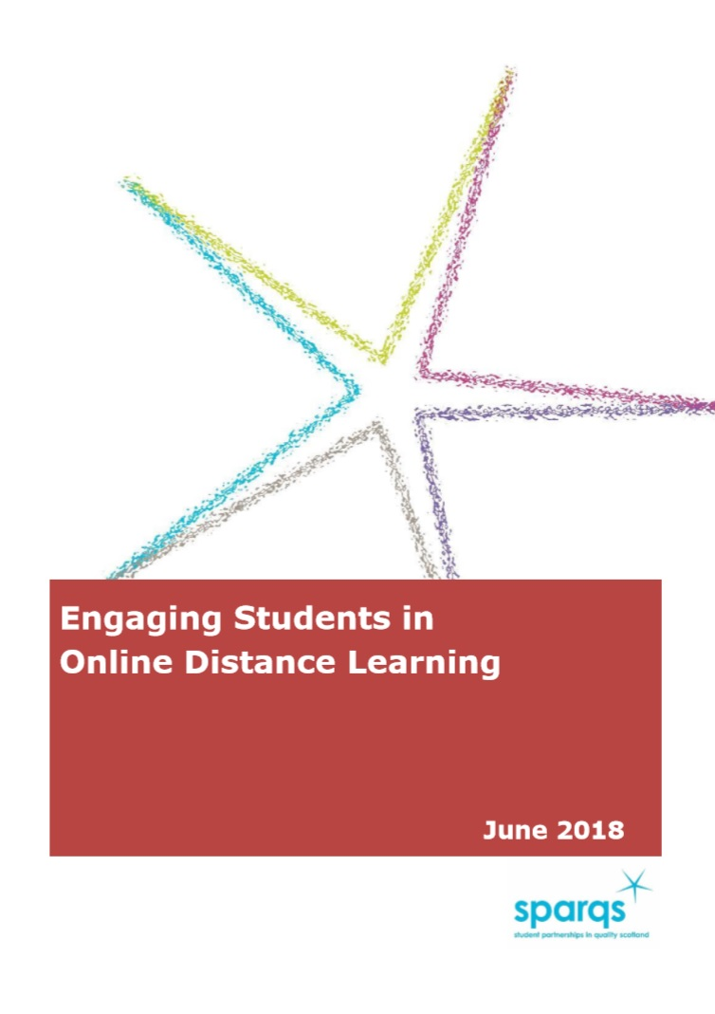
The process
6 universities
Project meetings
Institutional work
Desk research
2 key chapters:
Structures
Shaping L&T

Slide 12
The structures
Stand back and look at the big picture (p8 onwards).
Reflect on your rep structures (p10):
Who represents ODL students? What are the skills and knowledge required?

Slide 13
The structures
The constituency of a course rep
Job description
Promoting the role of course rep
Flexibility of system
The international dimension
School or department level

Slide 14
The structures
Stand back and look at the big picture (p8 onwards).
Reflect on your rep structures (p10):
Who represents ODL students? What are the skills and knowledge required?
Online training of course reps (p12)…

Slide 15
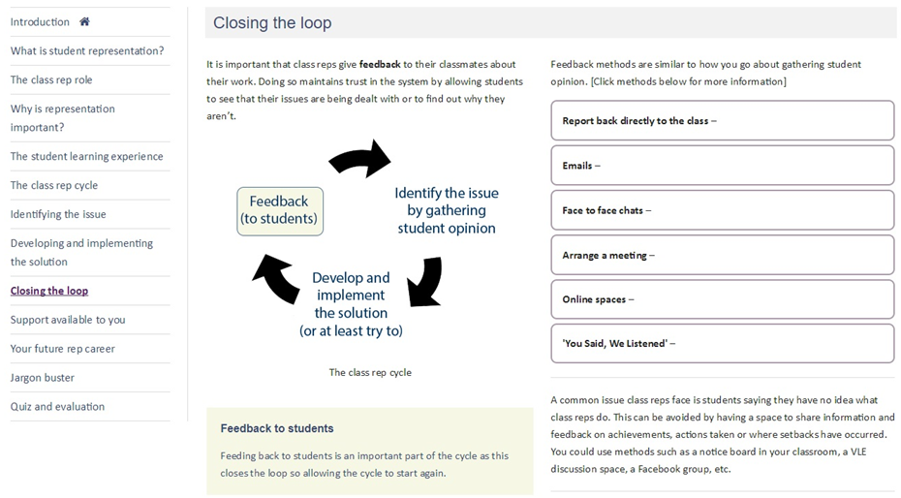
The structures

Slide 16
The structures
Stand back and look at the big picture (p8 onwards).
Reflect on your rep structures (p10):
Who represents ODL students? What are the skills and knowledge required?
Online training of course reps (p12).
VLEs & social media. (p15).

Slide 17
Shaping L&T
Role of ODL students in key processes (p19).
Partnership:
SPAs (p22).
L&T forums (p23).
Review activity – ODL as (p24):
Contributors
Topic of review
Programme lifecycles (p24 onwards).
Learning analytics and data (p28).

Slide 18
Now look at p20!

Slide 19
Questions? Comments?
More information:
The resource itself:
https://www.sparqs.ac.uk/institute.php?page=525
Scotland’s Student Engagement Framework:
https://www.sparqs.ac.uk/culture.php?page=168
My contact details:
https://www.sparqs.ac.uk/staff.php

