Slide 1
Using (panel) feedback to increase student satisfaction
David Watt – Sector Manager | M.Mus Programme Leader
University of the Highlands and Islands – Perth College
February 2017
Notes:
Share some of the things we’ve been doing – what’s gone right. What hasn’t – some of the challenges we still have.

Slide 2
SCHEDULE
INTRODUCTION AND CONTEXT (NSS 14-15)
RESPONSE | ANALYSIS
THE VALUE OF FEEDBACK
POOR AND POSITIVE FEEDBACK
MUTUTALLY CONSTRUCTED FEEDBACK
IMPLEMENTATION
NOT JUST MCF.... WHAT TO AIM FOR
SUMMARY
Q AND A

Slide 3
UHI ACADEMIC STANDARDS AND QUALITY REGULATION 17b.35
Students shall be informed of their progress throughout the programme and have the opportunity of regular contact with their personal academic tutor (PAT). Students’ work will be marked and feedback given with an appropriate timescale (normally not more than 15 working days from the date of submission). Where this is not deemed to be possible, students should be informed of when the work will be returned.
METHOD:
written, spoken, audio or video (recorded)
CAN’T MAKE 15 DAYS?
Inform students when (and where) they will receive feedback
Notes:
Certain Confusions – Feedback is written…
15 days – NORMALLY – let the students know if it’s difficult.
If Marking Overload Occurs, is it indicative of (student) assessment overload – can the process be managed more efficiently, or designed better?
Reflections

Slide 4
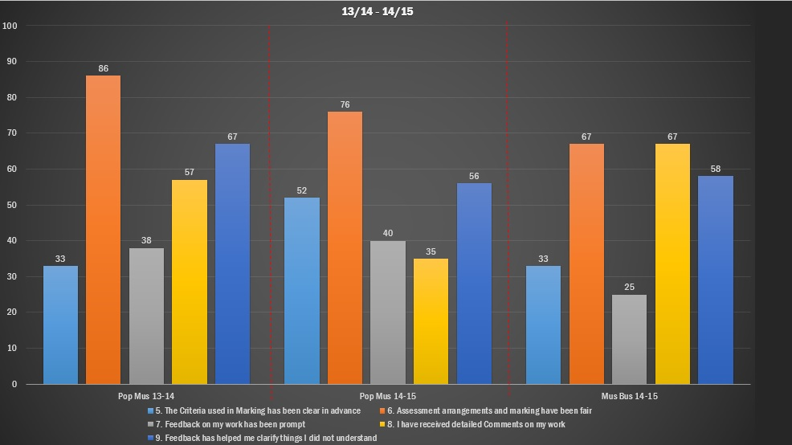
Notes:
Context:
Sudden change of BA4 PAT/PL/SL in Aug 14
PAT – Student Rep difficulties 14-15.
Low Satisfaction – HUGE MORALE PUNCTURE… BIG KICK IN THE STOMACH
Similar issues in Audio Engineering.
PERCEPTION / ENGAGEMENT KEY

Slide 5
Notes:
Context:
Low Satisfaction – HUGE MORALE PUNCTURE… BIG KICK IN THE STOMACH at the Beginning of the Year. Framed the context.
Sudden change of BA4 PAT/PL/SL in Aug 14
PAT – Student Rep difficulties 14-15.
Student Profile:
Creative (EGO)
Low Entry at HNC (wide range of abilities)

Slide 6
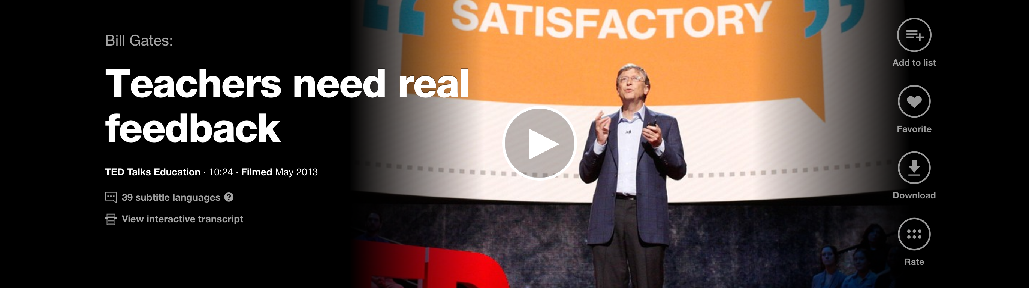
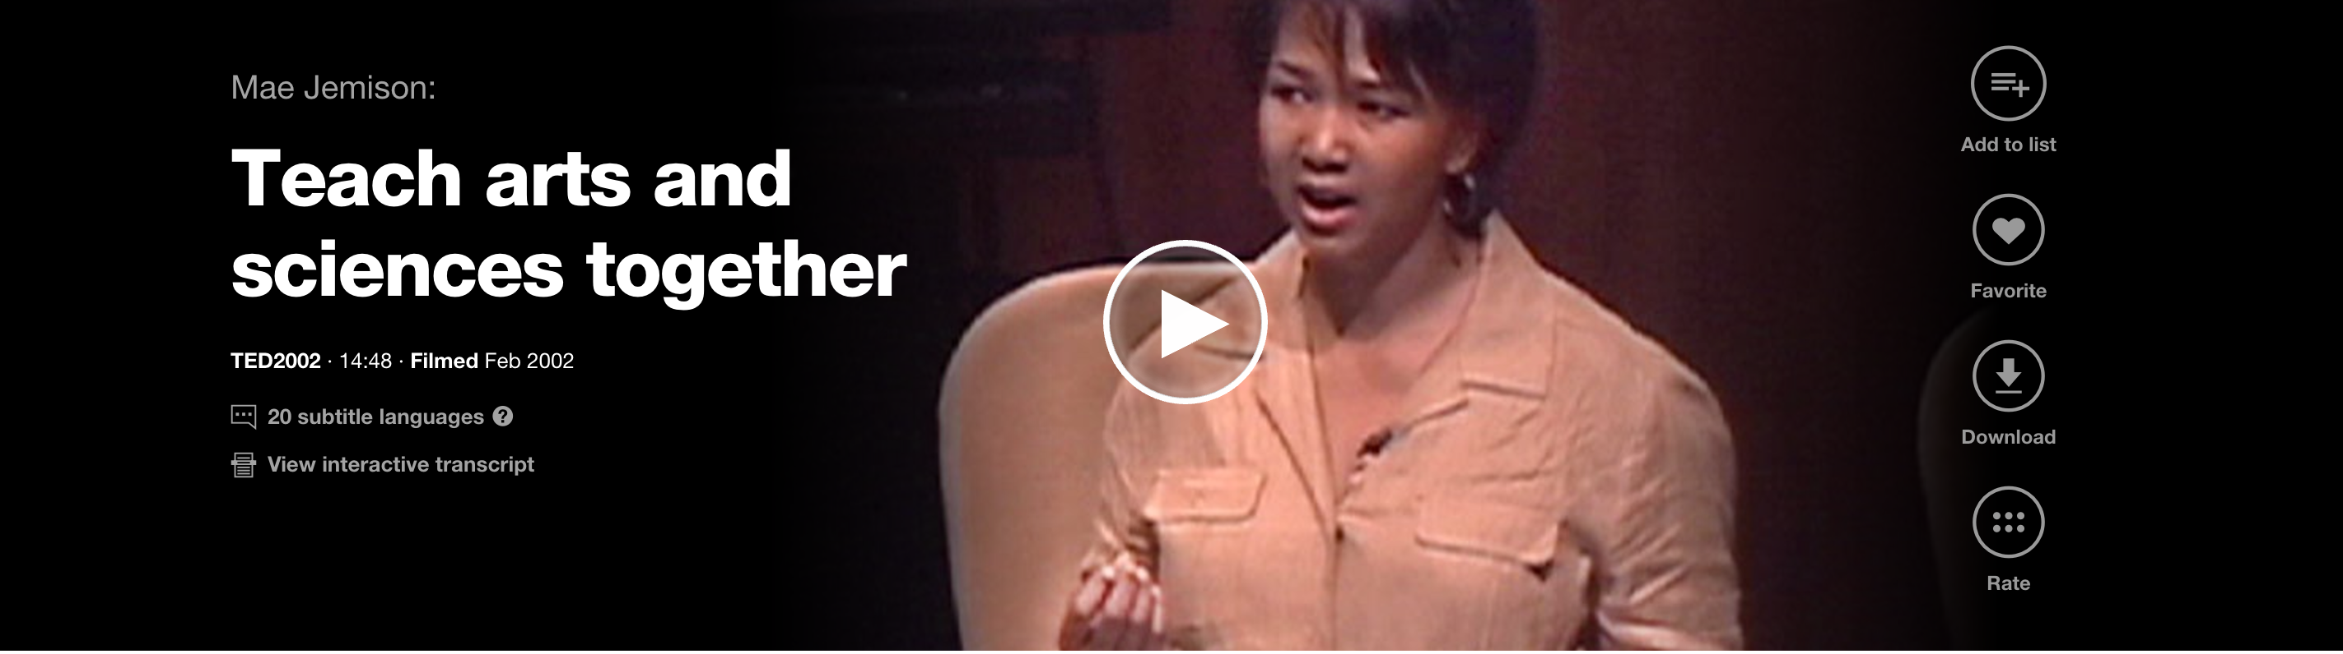
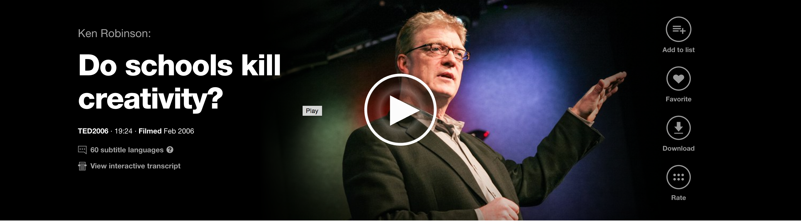
Notes:
Some examples of online soul-searching regarding teaching, assessment and feedback.
Prevalent issue:
Gates: 2,066,769
Jemison: 690,893
Robinson: 43,305,121 (Critique of American Education: 6 million)
- ability to make mistakes is how we learn – use this to shape.
- Story about the dancer.

Slide 7
“Nothing that we do to, or for, our students is more important than our assessment of their work and the feedback we give them on it
The results of our assessment influence our students for the rest of their lives and careers - fine if we get it right, but unthinkable if we get it wrong.”
Race, Brown and Smith (2005), 500 Tips on Assessment
Notes:
TEACHING
LEARNING
ASSESSMENT – FEEDBACK!
IMPORTANCE OF FEEDBACK (and FORWARD)
NSS advice – if student received a bad feedback in Yr2, they’re going to remember it
ALSO, STAFF DEVELOPMENT – HOW DO WE DELIVER EFFECTIVE FEEDBACK TO EACH OTHER?
DO WE?

Slide 8
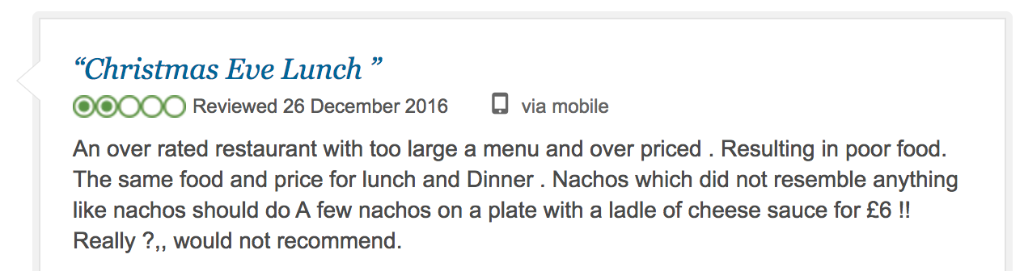
HOW DO YOU FEEL WHEN YOU RECEIVE UNHELPFUL, NEGATIVE OR POOR FEEDBACK?
Response:
Deflated
Confused
Angry
Loss of confidence
Demotivation
Opposition
Denial
Notes:
Feedback? Not really – just opinion, no qualifier, no response from vendor, no evidence of action after.
In worst cases – venting.
It’s really easy to be negative, much harder to be positive – especially in a profession known for critique
Important – this is the culture that our students are/have grown up in.
Web 2.0 – interactivity and social media = comment culture
How valuable is negative feedback?
To whom does it serve?
How do we know feedback has been implemented?
When we give feedback:
Unhelpful Marker Habits:
‘Use Harvard’
‘Bad grammar here’
Lack of specificity
No connection with the student
Must try harder
Some practices that if we’re honest, still happen:
No feedback
Illegible feedback
Late feedback
Disconnected feedback
Unhelpful feedback
Uncollected feedback
Reasons:
Rushed, Lack of Time, many scripts. Look at assessment and module design!

Slide 9
HOW DO YOU FEEL WHEN YOU RECEIVE POSITIVE FEEDBACK?
‘Just messaging to say a huge thank you for the mark. It is beyond my wildest dreams for dissertation! Thank you so much for all your guidance and support, and for turning the dissertation experience around into a positive one! …… so happy! Waiting on the last result for PES and official results….
All the best for the future’
Notes:
Emotion:
Proud of and for the student
Satisfaction
Glad to make a difference
Glad to be part of their journey

Slide 10
“It isn’t feedback unless there is subsequent evidence of its effect”
David Boud, in Pirie (2015)
Notes:
Feedback as a learning tool
Feedback as an assessment tool
Feedback at the centre….
Creative Arts:
Small Ratios = Detailed Comments 1:1, Master – Apprentice, Maestro – Student Model
Evident in Music Industries: e.g Recording Studios (Teaboy), Band Trials – Cruise Ships.
Creative Arts (Studio – Apprentices)
Observation / Experimentation / Feedback – learning and industry practice.
Feedback is at the centre, but Students (and staff) may not know this.

Slide 11
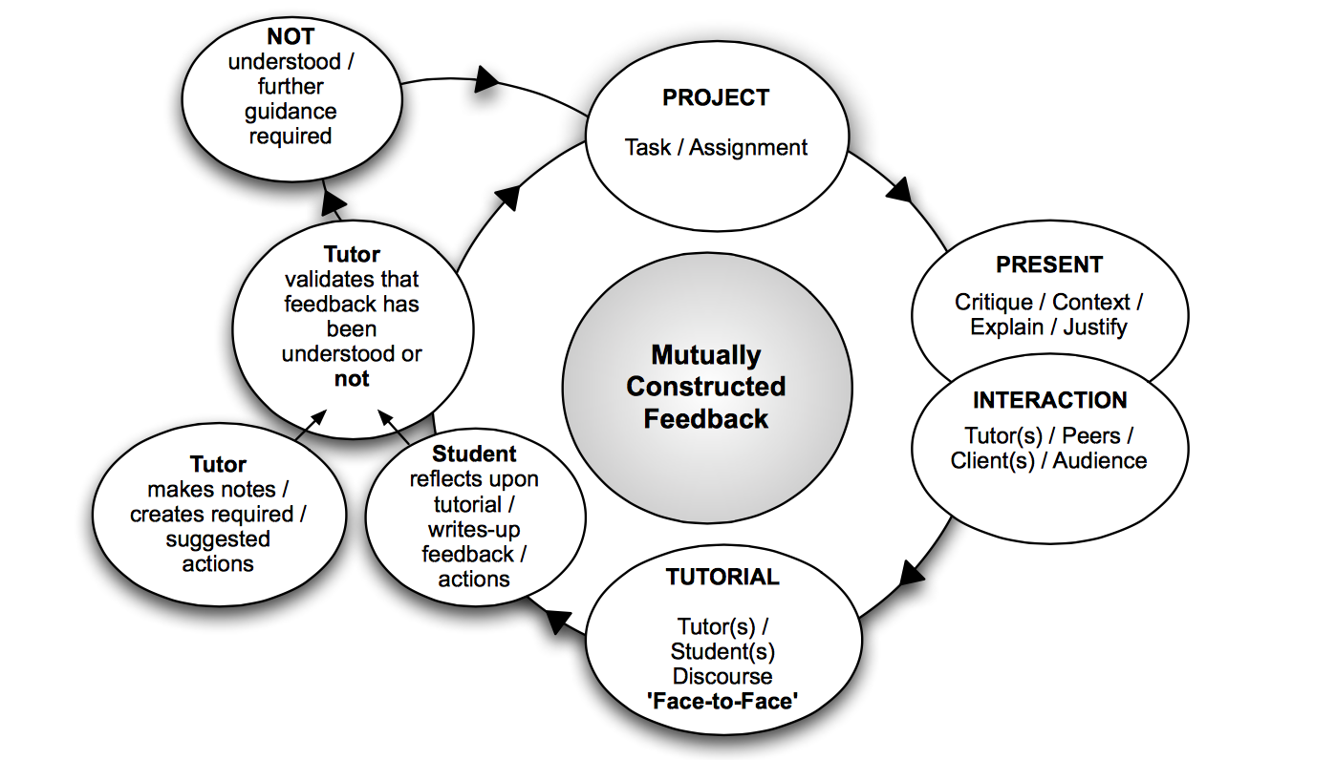
Pirie, 2011
Notes:
Based on Kolb’s Learning Cycle
Use at ECA for their project work – SC modules mostly because of development and incubation time required for creative projects
Begins with the project

Slide 12
MUTUALLY CONSTRUCTED FEEDBACK: PROCESS
Assessment feedback received by student
Panel Crit
Notes taken by staff/panel
Notes taken by student
Notes used for validation
Pirie, I., Cordiner, S., Triggs, J. 2011. Digital Spaces for Learning and Assessment in Art and Design
                Designs on eLearning 2011.Edinburgh College of Art
Notes:
PROCESS:
Crit model takes place at halfway point
Requires some work to set up and organise - if necessary, a week of lessons can be sacrificed however it occurs in the inter-semester break in early Jan. 8 week break between S1 teaching end and S2 teaching start..

Slide 13
MUTUALLY CONSTRUCTED FEEDBACK: BENEFITS
Reinforces Community of Practice: shared contribution, problem –solving and support
Holistic – Student as One, not a collection of modules, or assessments
‘Big Picture’
MUTUALLY CONSTRUCTED FEEDBACK: CHALLENGES
Organisation – Feedback matters, plan it into the schedule (look for free times)
Staff Buy-in
Notes:
Students do not often see staff together discussing their work. Especially helpful when staff can problem-solve, or encourage especially in ‘big picture’
Collaborative approach from all
Very positive student response “I felt valued, supported”
Eventual buy-in from staff, initially resistant.

Slide 14
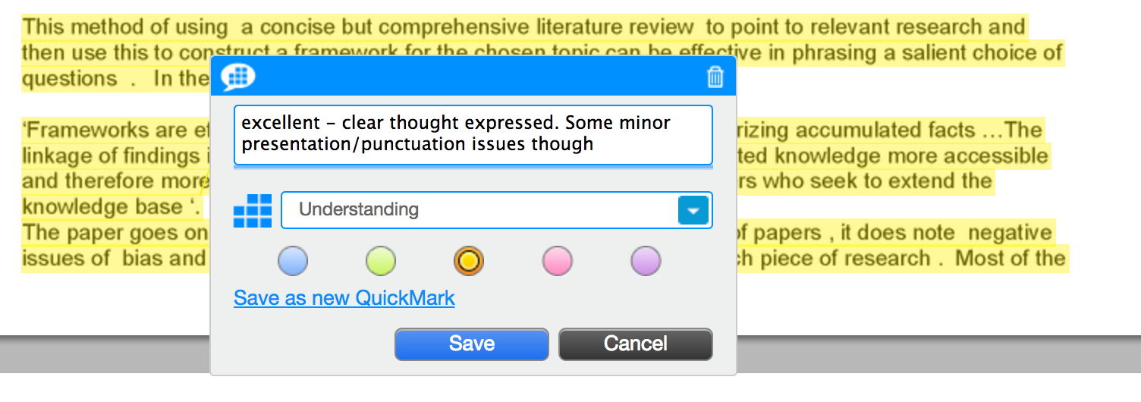
NOT JUST MCF: CLARITY AND CONSISTENCY (SMALLER CHANGES)
Feedback dates published on assessment briefs (module handbooks).
Use of qualitative rubrics including criterion statements across all assignments.
    Exercises using rubrics and criteria
Using turnitin to link ‘in-text’ comments to grading criteria
Feedback Policy
Notes:
Publishing feedback dates has really helped – there have
Using rubrics to provide qualitative statements – so that the rubric becomes a useful tool
Students rewrite the learning outcomes, put them into their own words and contextualise them to the assignment. Staff approve them as being an accurate understanding of the intended learning (or not). The problem with learning outcomes is that the only person who understands them is the person who wrote them.
Students (re)mark last year’s work using assessment criteria

Slide 15
WHAT TO AIM FOR
Explicit assessment criteria directly related to learning objectives
Assessment grades directly aligned to learning outcomes
Shared clarity of purpose, values and expectations
Exemplars and rubrics
Development of assessment literacy in students
Extensive use of formative, self and peer-assessment
Team-based staff development in assessment
(Pirie, 2015)
Notes:
Constructive alignment from Grading Criteria, through Assessment Grades to Learning (Objectives)
SHARED PURPOSE – COMMUNITY OF PRACTICE
Developing awareness and assessment literacy in students – how many students say ‘I can’t find my feedback’ or ‘I didn’t understand what you meant?

Slide 16
Notes:
Similar +ve effect in BSc Audio Engineering

Slide 17
SUMMARY
INTRODUCTION AND CONTEXT (NSS 14-15)
RESPONSE | ANALYSIS
THE VALUE OF FEEDBACK
POOR AND POSITIVE FEEDBACK
MUTUTALLY CONSTRUCTED FEEDBACK
IMPLEMENTATION
NOT JUST MCF.... WHAT TO AIM FOR
SUMMARY
Q AND A
Notes:
Context and Value of Feedback
Some of the mechanisms involved
MCF

Slide 18
ANY QUESTIONS?
(01738 8)77413
pe09dw@uhi.ac.uk
@david_watt

