Slide 1
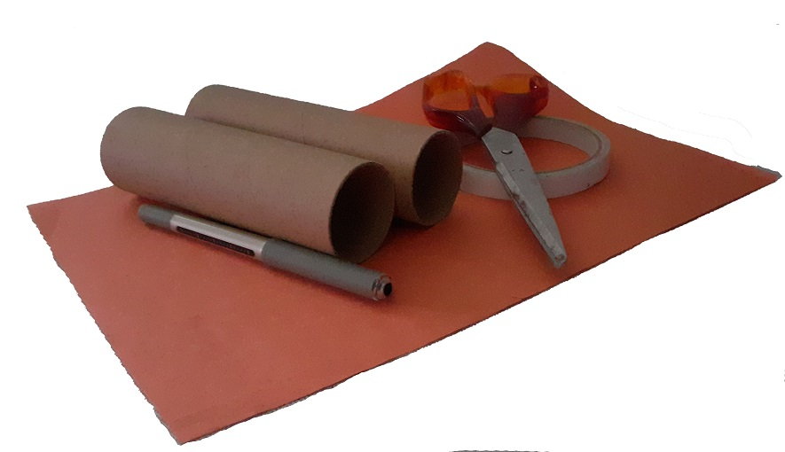
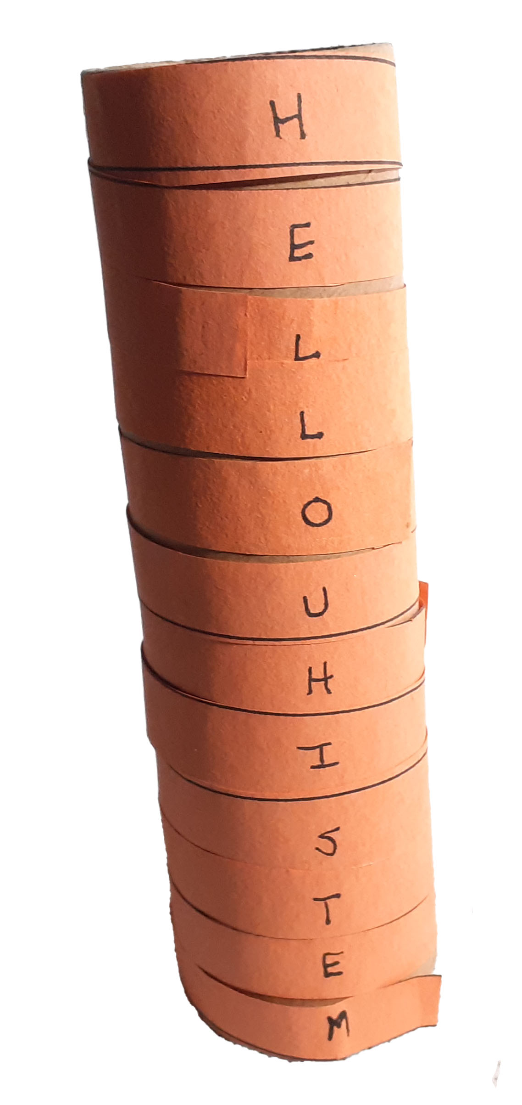
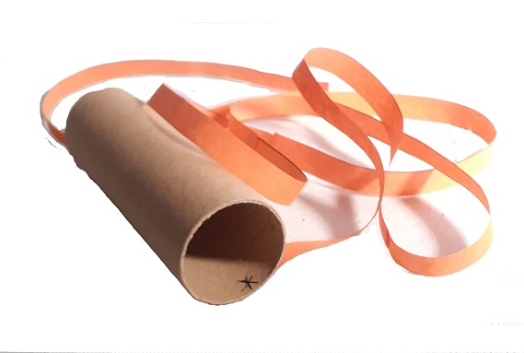
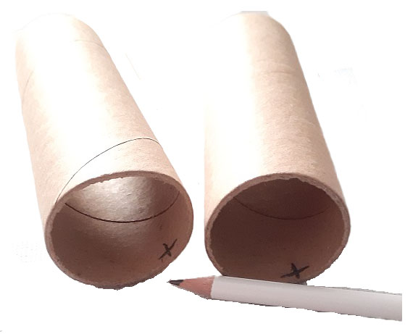
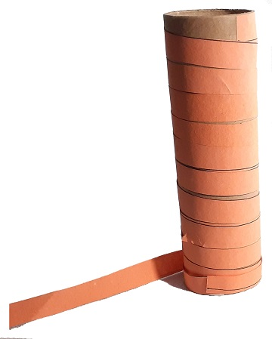
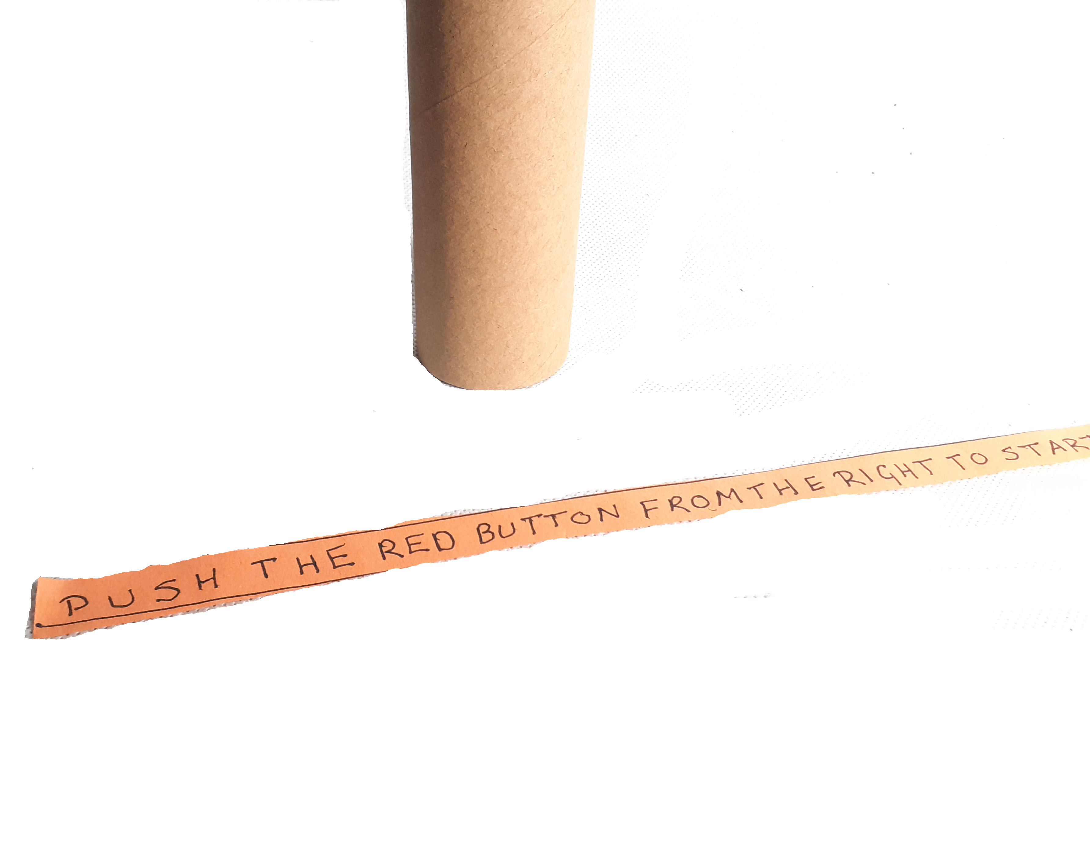
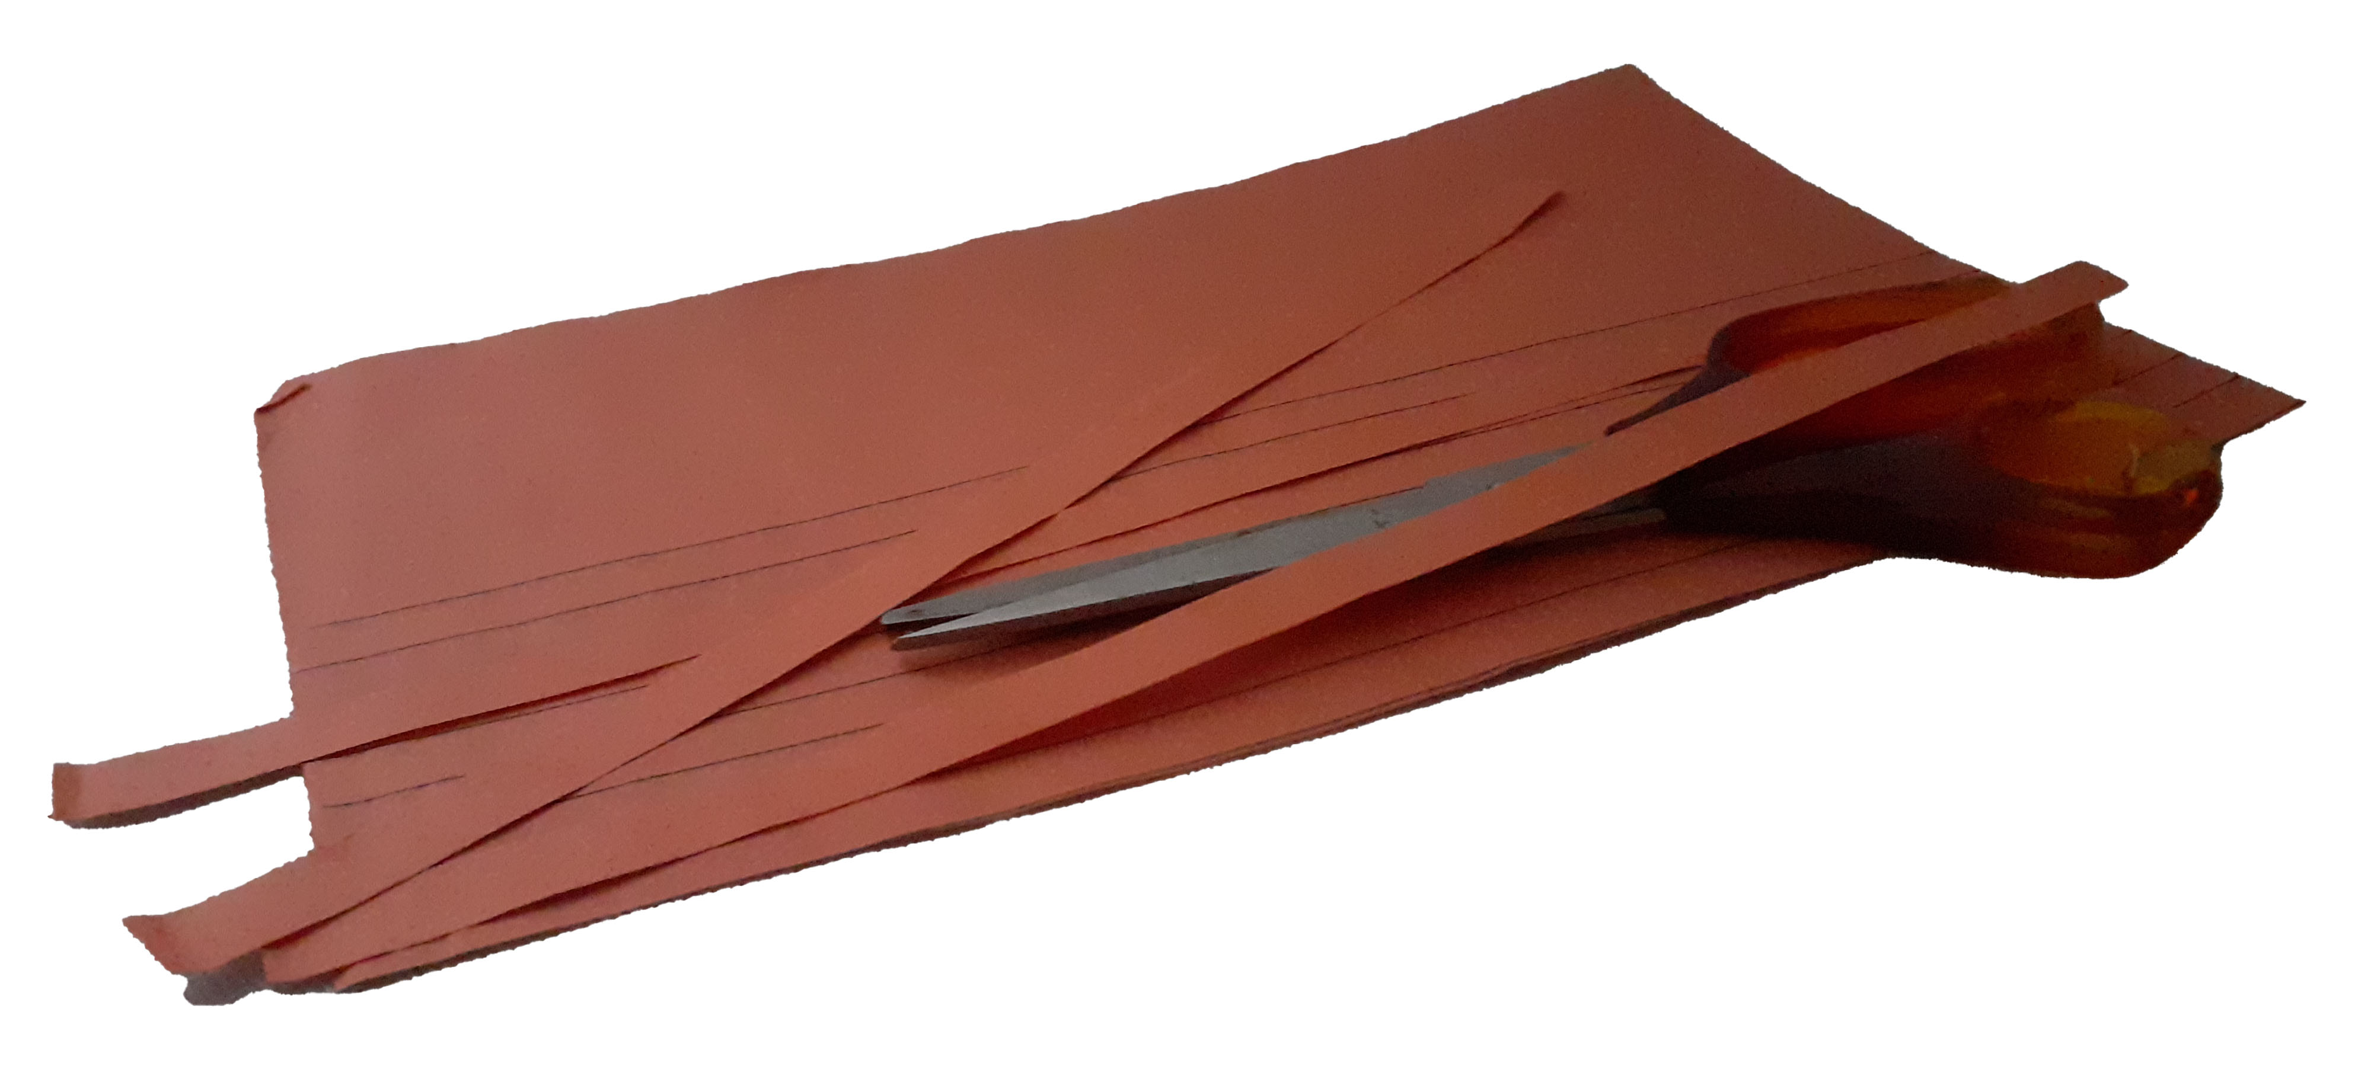
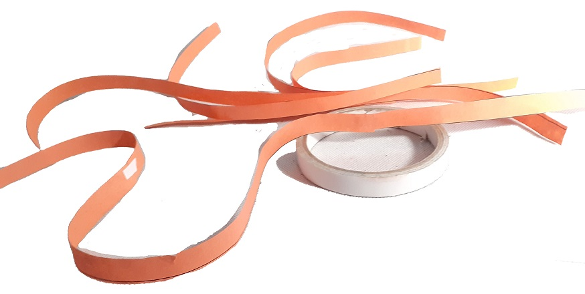
Scytale messages
Code a message using ancient techniques.
What you need
• Cardboard tubes (x2) • Pen • Paper • Sellotape • Scissors • OPTIONAL Ruler
1.
Make the Code a Decoder tubes.
Take two identical carboard tubes and make a mark on each to indicate the starting point for your message.
3.
Attach the paper on to the tube at the starting point you marked at step 1.
5.
Now to write your message. Near the starting point (the mark on the tube) write one letter on the strip. Move to the next strip and immediately below the 1st letter, write the next letter of your message. Work your way down each section until your message is complete.
.
4.
Carefully turn the tube and wind the strip over the surface of the cylinder matching the edge until you cover the tube (do not overlap the paper).
6.
Take the strip off your tube and fill in all the gaps in the tape with other letters. You might want to add a letter or two before your starting letter. Role the tape up and send to your friend (who has tube 2) to decode. Remember to give a number for the starting letter position e.g., 4.
Give one tube to the person who will receive the coded message.
2.
Fold or draw lines along the paper to create thin columns 5cm long. Cut the paper into thin strips and attach them together using sellotape to make one long strip.

Slide 2
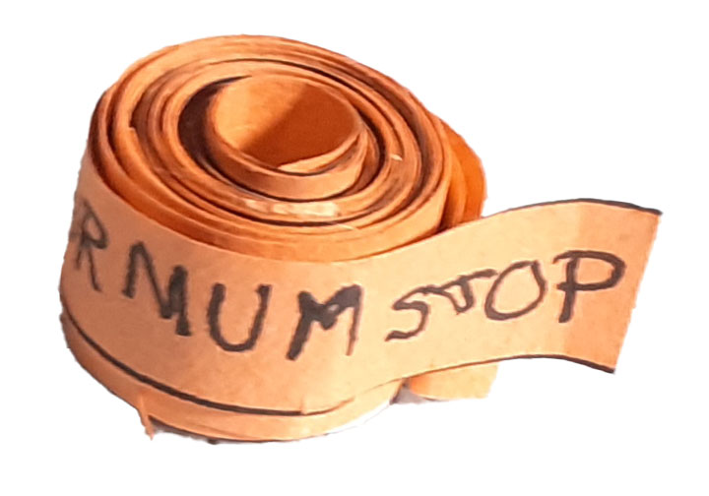
scytale message uses circumference, the distance around the outside of a round object, to carefully line up the wraps of paper. An object of a different diameter, the measurement straight across the middle of an object, has a different circumference. To find the circumference of an object, use π(pi) and the object’s diameter:
The Science
A scytale uses circumference, the distance around the outside of the cylindrical object, to carefully line up sections of a paper tape. In order to decode the message, you need an object of the same circumference and need to know the starting point (letter number to begin at). To find the circumference of a cylinder you need to use pi (3.14) and the diameter the object.
Circumference = 3.14 X Diameter
Small changes in the diameter of the object can significantly change its circumference. A scytale (message strip) wrapped around an object of the wrong circumference will not line up and the message cannot be read. In addition, by not using the first letter you are adding extra protection. The person who reads the message must have an object of the same circumference and know which letter to begin at.
Diameter

