Slide 1
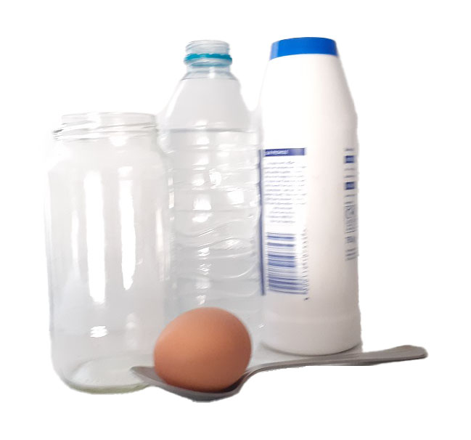
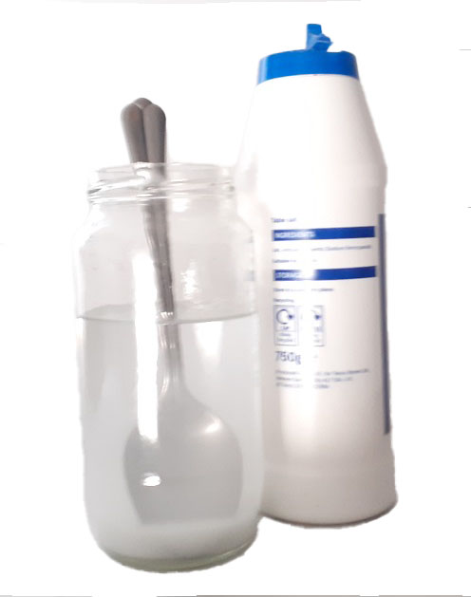
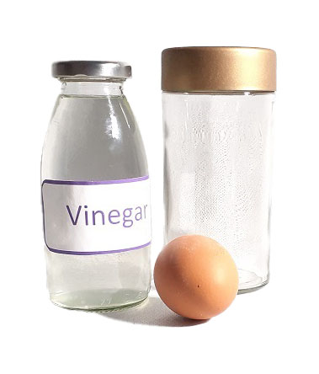
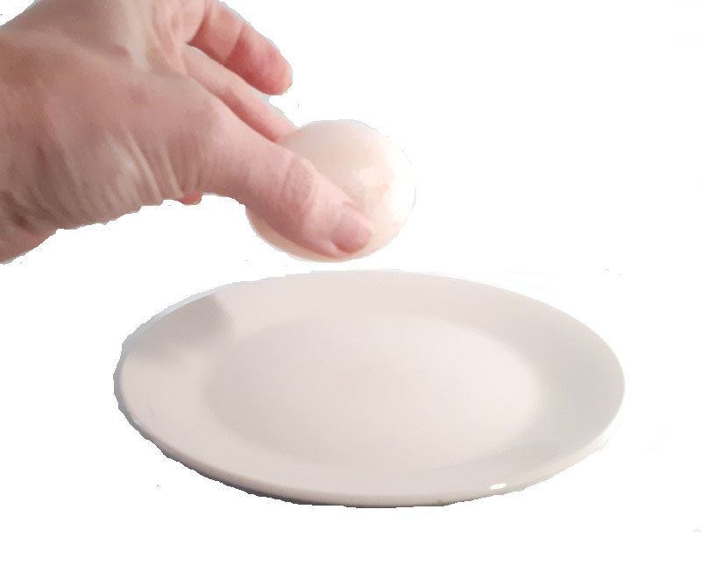
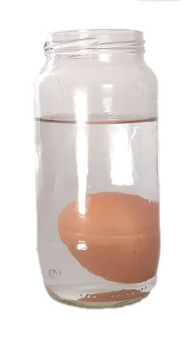
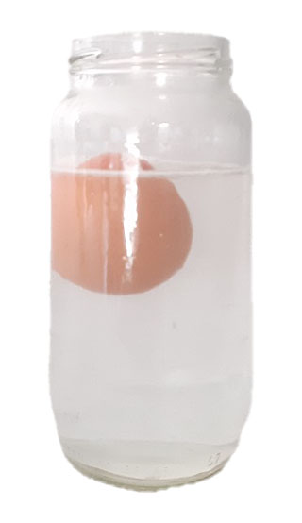
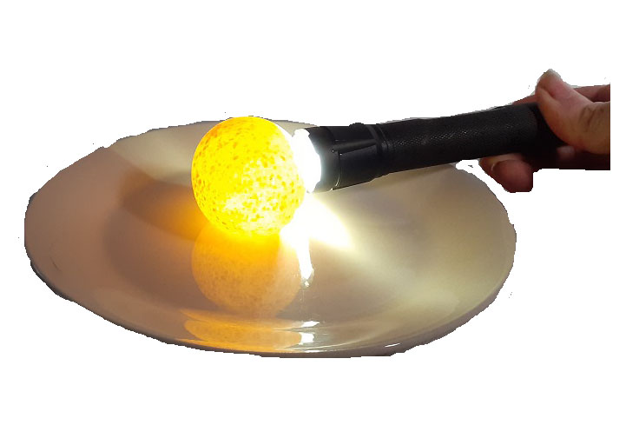
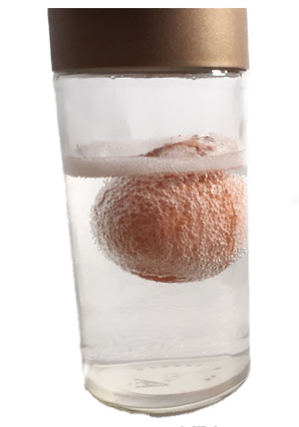
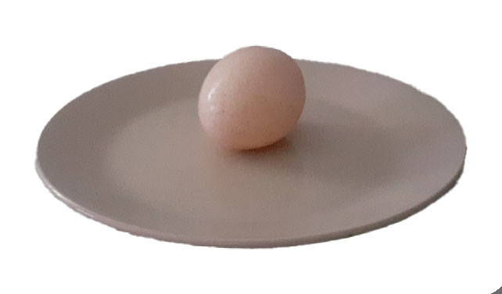
Eggsperiment
It is amazing what you can do with eggs...
What you need
Floating Egg • Large jar or clear plastic container • Spoon • Water • Egg • Salt
Bouncy Egg • Large jar or clear plastic container • Vinegar • Water • Egg • Plate • Torch
Osmosis • 3 x Bouncy Eggs • Salt • Water • Fizzy drink (Sprite/ lemonade/ cola) • Concentrated diluting juice • 3 x wide topped jars to hold eggs
•Plate • Measuring scales
1.
Floating Egg.
Fill a container (or jar) ²/₃ full of water.
3.
Using the spoon carefully remove the egg from the container. Add 10 spoons of salt. Stir until all the salt is dissolved.
1.
Bouncy Egg.
Pour enough vinegar to submerge the egg into container (about ½ full ), add an egg and place in refrigerator.
3.
Hold the egg a few centimetres over a plate and let it go.
What happens?
Try raising the egg higher and letting it go.
.
2.
Every few hours check egg to see if anything has happened to the shell. After 24 hours remove egg from vinegar and rinse the egg carefully with water (you do not want to break the membrane). Pour the vinegar down the sink.
2.
Using the spoon carefully add an egg to the container. Watch what happens.
4.
Using the spoon carefully add an egg to the container. Watch what happens.
4.
Shine a torch next to the egg. What happens? Try shining a torch beside a regular egg and compare.

Slide 2
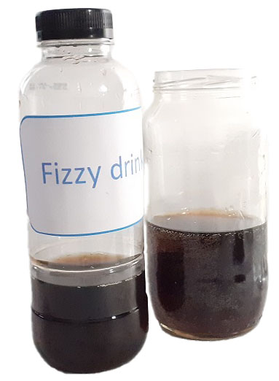
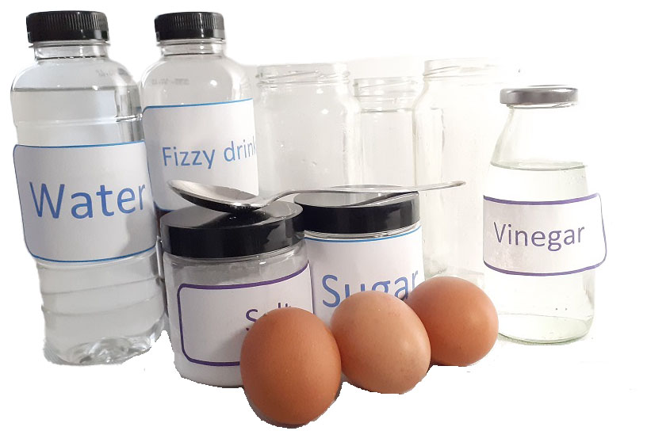
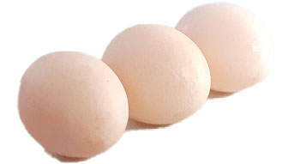
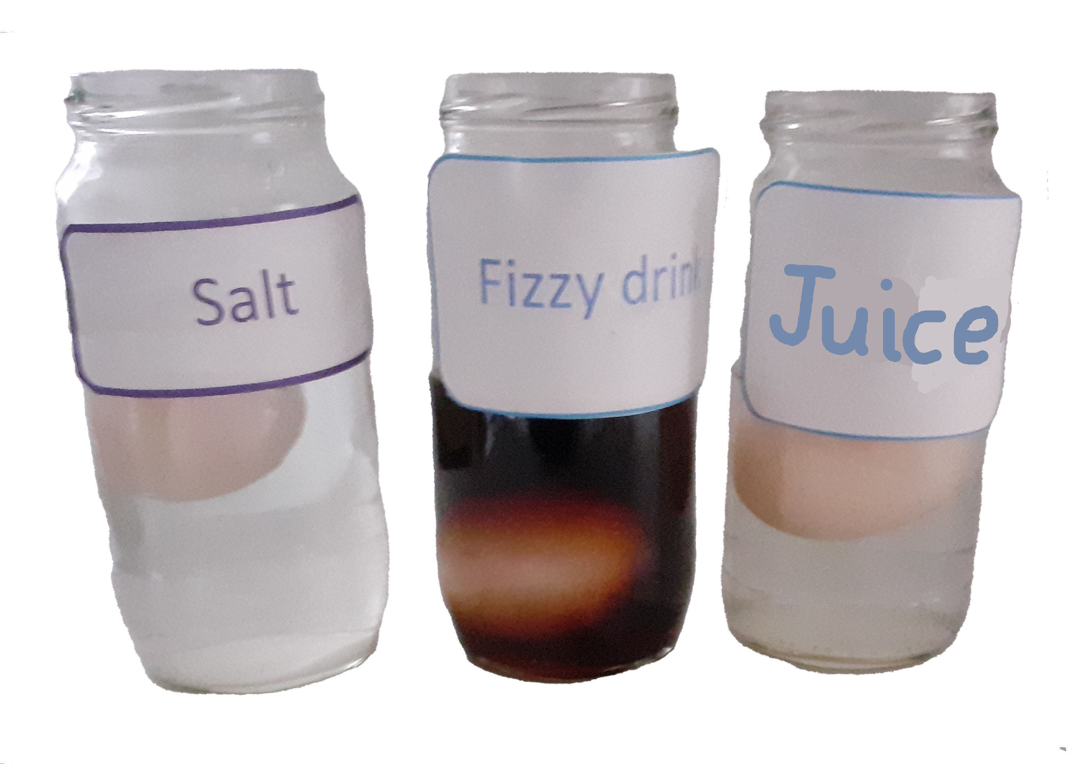
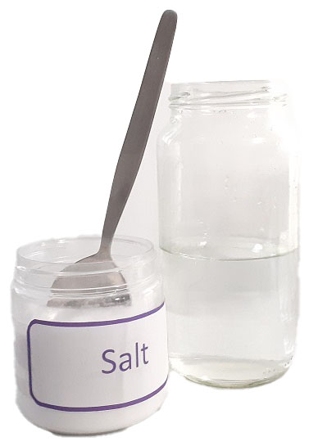
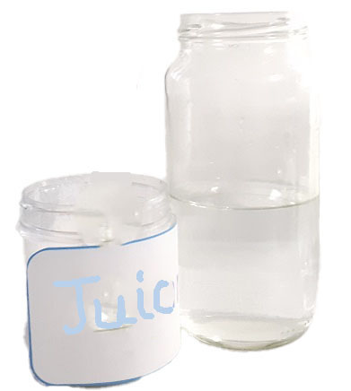
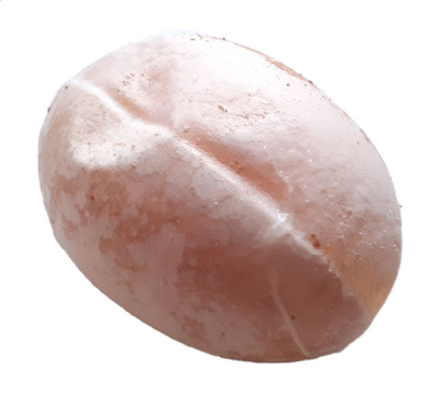
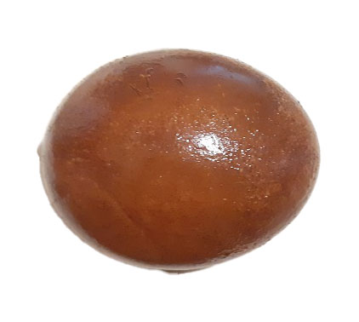
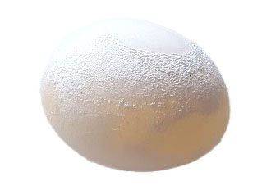
1.
Osmosis
Make three bouncy eggs. Weigh each egg on kitchen scales and record weight.
3.
Fill jar 2 half full of fizzy juice. Label the jar ‘FIZZY JUICE’.
5.
Gently place one egg into each jar. Place jars in fridge and check eggs every few hours see what happens. After 10-12 hours gently remove eggs from jars.
2.
Fill jar 1 half full of water. Add 30 tablespoons of salt and stir until as much as possible has dissolved. Label the jar ‘SALT ‘.
4.
Fill jar 3 half full of a diluting juice concentrate. Label the jar ‘JUICE’.
6.
Look at the eggs and compare them. Have any changed in size? Weigh each egg again.
Be gentle and try pressing them.
The Science
Floating Egg. This experiment is about density. Density is all about the amount of matter in a space - the more the matter the denser it is said to be. In this experiment we have one egg and two different solutions. Solution one is fresh water, and the egg is denser than the fresh water, so it sinks. The second solution is salt water which has a higher density than fresh water. If there is enough salt, the egg will be less dense than the solution and will float.
Bouncy Egg. Eggshells are made from a mineral called calcium carbonate. Vinegar is a weak acid and when you submerge the egg in it the acid reacts with the calcium carbonate. During this reaction, carbon dioxide is formed and the eggshell dissolves. When you rinse the egg, you remove this ‘dissolved eggshell’ and are left with the thin outer membrane inside the egg. This membrane is translucent, so it allows light to pass through it. The membrane, although soft, has been toughened by the vinegar and is quite rubbery, therefore the egg can now bounce. Be careful as the membrane can break.
Osmosis. This experiment is about the membrane of the bouncy egg and the chemical process called osmosis. Osmosis describes the movement of water from a less concentrated solution to a more concentrated solution (making it weaker until the solutions match). Depending on the solution you use, some water will move into the egg making the solution less concentrated and the egg bigger, or moves out of the egg making it smaller (solution more concentrated).

